Slide 1
Open Source Platform and Network Administration
Lesson 18

Slide 3
Configure Protection on a Web Site
Customize the ssl.conf file for the desired secure Web site
Configure a certificate authority (CA)
For a self-signed certificate, use the openssl command
Notes:
Customize the ssl.conf file for the desired secure Web site
Configure a certificate authority (CA)
- For a self-signed certificate, use the openssl command

Slide 4
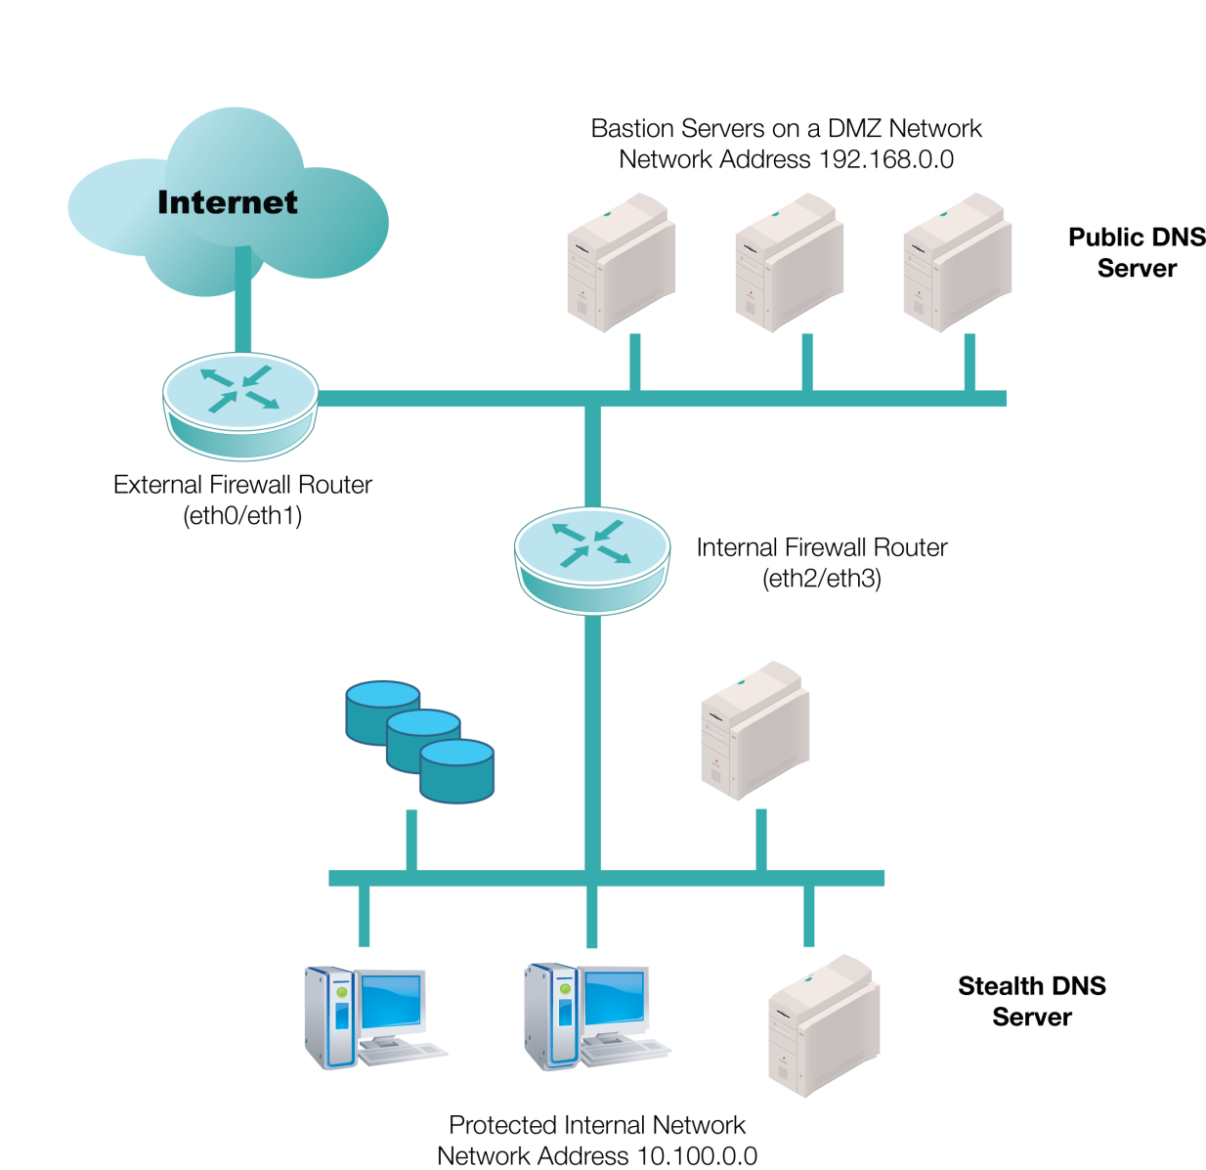
An Internal Network, a DMZ, and the Internet
Notes:
The best place to protect the master authoritative DNS server for a domain is on an internal network, protected by multiple firewalls.
DNS server functionality for the domain is split between a public DNS server (possibly within a demilitarized zone [DMZ]) and a stealth DNS behind a firewall.

Slide 5
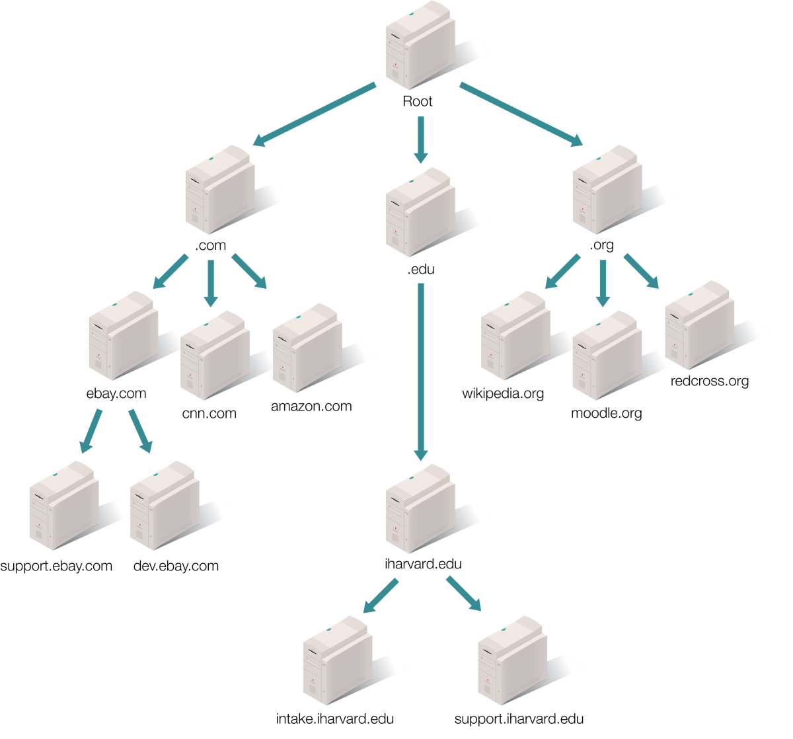
DNS Organization of the Internet

Slide 6
Mail Transfer Agents
MUAs
Mail User Agents (MUAs): E-mail client applications; Evolution, Thunderbird
MRAs
Mail Delivery Agents: E-mail services that send mail to client applications
Mail Retrieval Agents (MRAs): Services that collect e-mail from networks; fetchmail
MDAs
MTAs
Mail Transfer Agents (MTAs): Used by applications to send messages for delivery; Sendmail, Postfix

Slide 7
Asterisk
Open source VoIP software
Uses Session Initiation Protocol (SIP) and the Real-time Transport Protocol (RTP)
Centered around the dialplan

Slide 8
Why Limit Network Printers?
Monitor usage
Must be able to track who prints what for management and budgetary reasons
Contain costs
Color printing is still much more expensive than b&w; limit who can print to networked color printers
Prevent a security breach
An attacker can hijack a networked printer and take control of the entire network

Slide 9
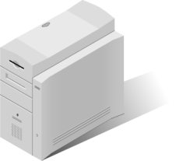


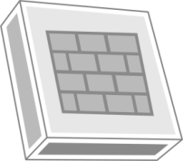
Port Forwarding with SSH
MySQL database management
Graphical user interface (GUI) tool
OpenSSH
Server (Port 22)
Firewall blocks
all traffic to Port
3306
MySQL Database
Server (Port 3306)
Port 22
Port 3306
Notes:
The administrator can use SSH to access the OpenSSH server and use port forwarding to access the database server with a GUI tool.

Slide 10
Summary
Common Web applications and services, such as Apache Web Server, Squid, DNS BIND, and mail agents
Configuring secure Web servers and Web sites
Digital certificates and certificate authorities (CAs)

